Slide 1


Microsoft Azure Machine Learning
Bianca Furtuna @Fur_Bi
Technical Evangelist
Microsoft

Slide 2
Descriptive
Predictive
Prescriptive
Intelligent action
What happened?
Why did it happen?
What will happen?
What should I do?

Slide 3
Cortana Intelligence Suite Transform data into intelligent action
Information Management
Big Data Stores
Machine Learning and Analytics
Intelligence
Data Sources
People
Data Factory
Data Lake Store
Machine Learning
Cognitive Services
Data Catalog
SQL Data
Warehouse
Data Lake Analytics
Bot Framework
Web
Apps
HDInsight
(Hadoop and Spark)
Event Hubs
Cortana
Mobile
Apps
Stream Analytics
Bots
Dashboards & Visualizations
Sensors and devices
Power BI
Automated Systems
Data
Intelligence
Action

Slide 4
Cortana Intelligence scenarios
EXAMPLE SOLUTIONS
Sales and marketing
Finance and risk
Customer and channel
Operations and workforce
Customer Acquisition
Fraud detection
Lifetime customer value
Pay for performance
Cross-sell and upsell
Credit risk management
Personalized offers
Operational efficiency
Loyalty programs
Product recommendation
Smart buildings
Marketing mix optimization
Predictive maintenance
Supply chain management

Slide 5

What is Machine Learning (ML)
Computing Systems that become smarter with Experience
Experience = Past Data + Human Input

Slide 6





What is Machine Learning (ML)

Slide 7



Why now?
+
+
=

Slide 8
Machine Learning Process Model
Idea
Data
Business Knowledge
Data Understanding
Data Preparation
Modelling
Evaluation
Publish
Based on the CRISP-DM Model
Re-train

Slide 9
What is Azure Machine Learning
Data
ML ecosystem
Clients
API
Blobs and Tables
Hadoop (HDInsight)
Relational (Azure SQL DB)
OData
Web Based ML Studio
Marketplace

Slide 10
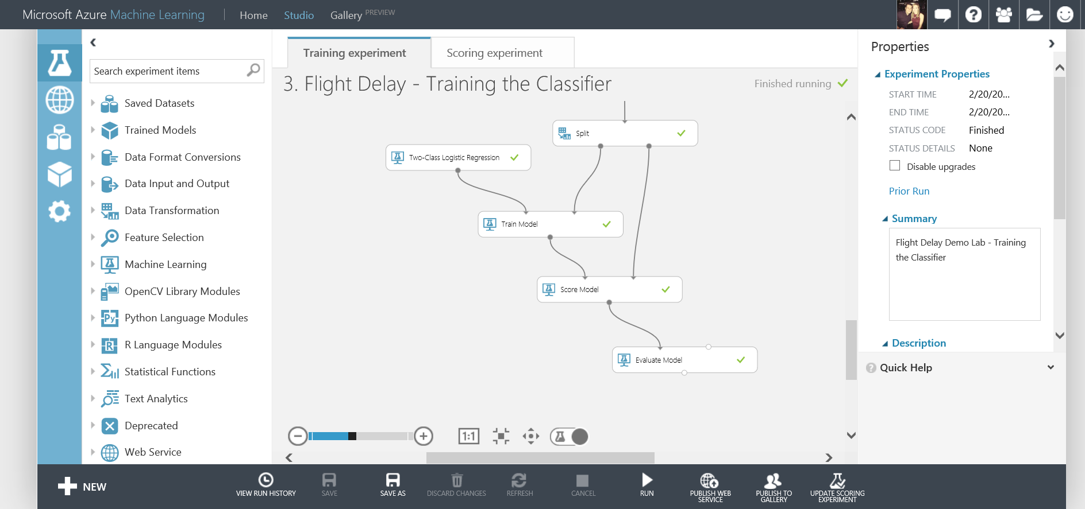
What is Azure Machine Learning
Fully managed cloud service
Accessed via a browser
Best in class machine learning algorithms
Support for R/Python/SQL
Collaborative data science
Quickly deploy models as web services
Publish to a Gallery

Slide 11
Azure ML Studio Lab
Flight Delay Scenario
Lab Resources are at:
http://aka.ms/techdaymltrack

Slide 12
Our Scenario
Create and publish a model that predicts:
Will a flight be delayed given a range of flight details and weather data.
Using two datasets: flight delay data and weather data
The model created will be a form of Supervised Learning and will use Binary Classification
Use historical flight and weather data to predict if a future flight is delayed or not.
Finally produce a web service you can query with new flights to gain a prediction

Slide 13
Azure ML Studio Demo

Slide 14
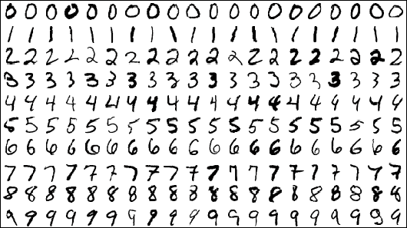
Digit Recognition with Neural Networks
Using a popular MNIST dataset – commonly used in Machine Learning Scenarios for testing Image Processing Systems
42,000 Images, each image is 28 x 28 pixels and each pixel has a value from 0 – 255
No images but a CSV file – 785 columns: label and 784 pixel colours

Slide 15
Azure ML Notebooks
R and Jupiter Notebooks
More information:
https://gallery.cortanaintelligence.com/notebooks

Slide 16
Azure ML Studio Demo
Retrain Machine Learning Models
More information:
https://azure.microsoft.com/en-us/documentation/articles/machine-learning-retrain-models-programmatically/

Slide 17
Machine Learning API’s
Cognitive Services
https://www.microsoft.com/cognitive-services

Slide 18

Microsoft Cognitive Services preview
Vision
From faces to feelings, allow your apps to understand images and video
Cognitive Services
Give your solutions a human side
Speech
Hear and speak to your users by filtering noise, identifying speakers, and understanding intent
Language
Process text and learn how to recognize what users want
Knowledge
Tap into rich knowledge amassed from the web, academia, or your own data
Search
Access billions of web pages, images, videos, and news with the power of Bing APIs

Slide 19
Microsoft Cognitive Services preview
Vision
Computer Vision | Emotion | Face | Video
Cognitive Services
Give your solutions a human side
Speech
Custom Recognition | Speaker Recognition Speech
Language
Bing Spell Check | Language Understanding Linguistic Analysis | Text Analytics | Web Language Model
Knowledge
Academic Knowledge | Entity Linking Knowledge Exploration | Recommendations
Search
Bing Auto Suggest | Bing Image Search | Bing News Search Bing Video Search | Bing Web Search

Slide 20
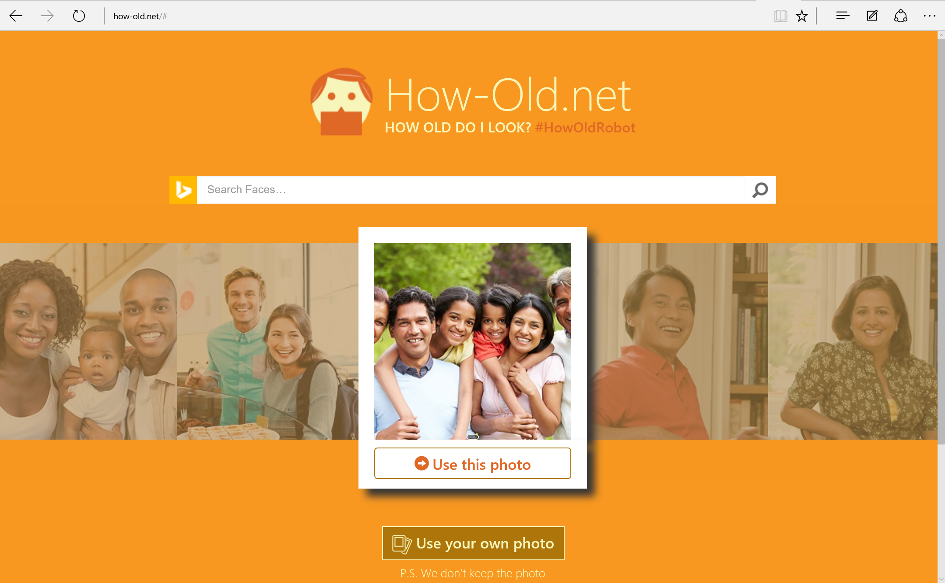

Slide 21
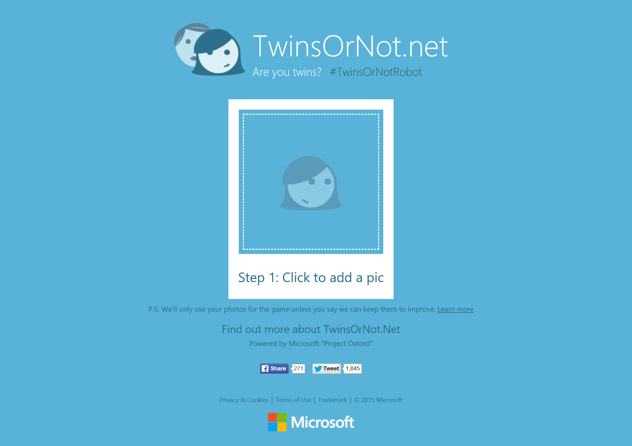

Slide 22
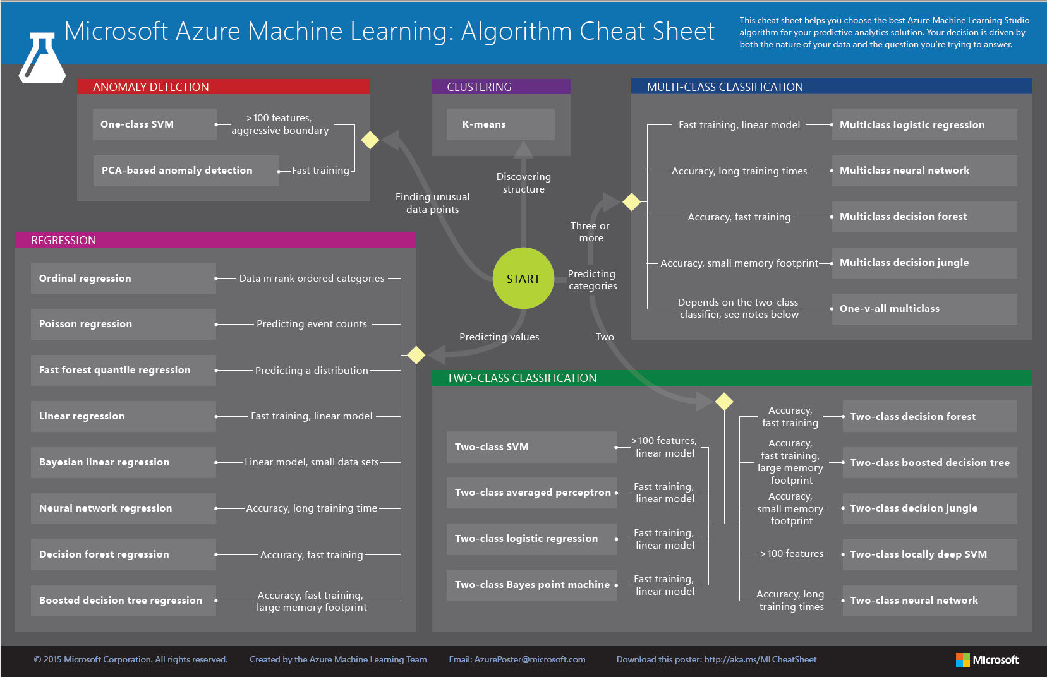

Slide 23

Next Steps
Explore the other Data Services available on Azure
Follow @Fur_Bi!
Find Azure ML Tutorials Available in the Gallery
Build you own solutions using Azure ML!
Get inspired by the examples in the Gallery and start exploring!
Watch the webinars on the Machine Learning Blog http://blogs.technet.com/b/machinelearning/
Do you have your own ideas?...

Slide 24





Thanks for Listening
bifurt@microsoft.com
http://furbi.azurewebsites.net/
uk.linkedin.com/in/biancafurtuna
@Fur_Bi

Slide 25
Resources
Microsoft Azure Machine Learning Algorithm Cheat Sheet
Microsoft Azure Machine Leaning Documentation
Channel 9 getting started videos for Azure Machine Learning
Using the Azure Machine Learning re-training API
Azure Machine Learning webinars available online to sign up to:
Azure Machine Learning Blog
Introducing Jupyter Notebooks in Azure ML Studio
EXCEL add-in for Azure ML

Slide 26
Advanced Resources
Neural Nets in Azure ML – an introduction to Net #
Quickstart tutorial for the R programming language for Azure Machine Learning

Slide 27
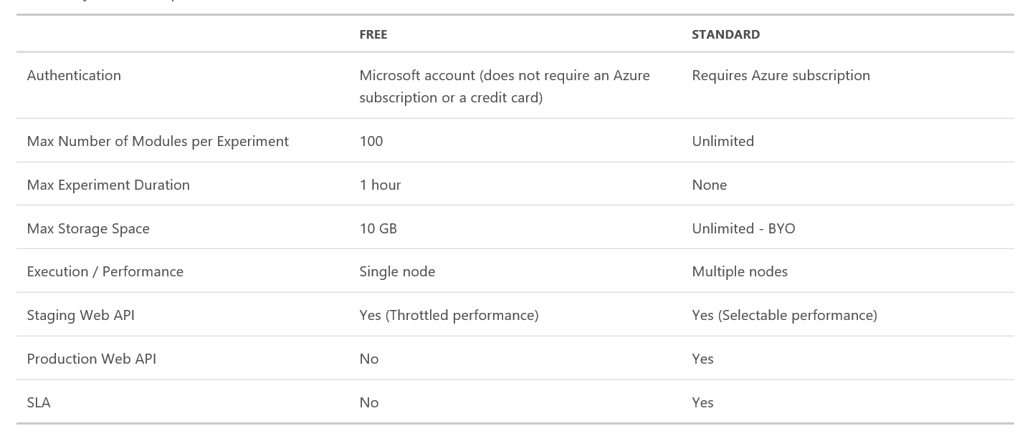
Azure Machine Learning Pricing
Data
Clients
ML STUDIO
Model is now a web service that is callable
Blobs and Tables
Hadoop (HDInsight)
Relational DB (Azure SQL DB)
Integrated development environment for Machine Learning

Slide 28
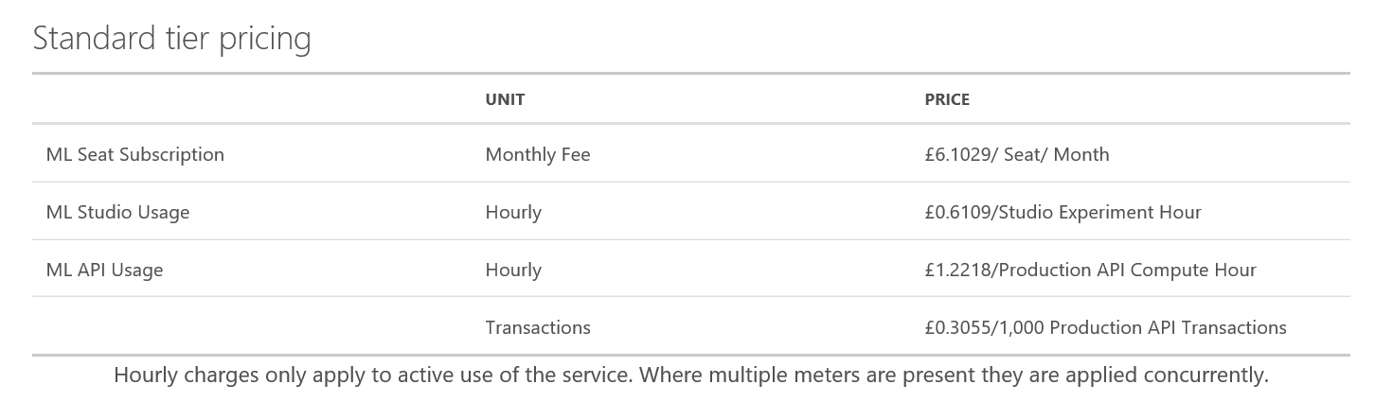
Azure Machine Learning Pricing
Data
Clients
ML STUDIO
Model is now a web service that is callable
Blobs and Tables
Hadoop (HDInsight)
Relational DB (Azure SQL DB)
Integrated development environment for Machine Learning

Slide 29
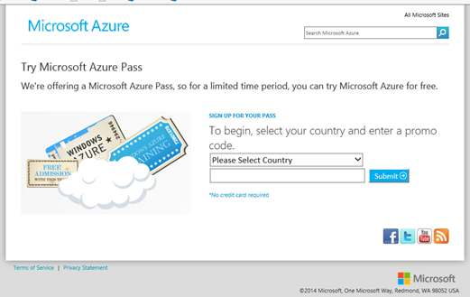
Redeeming Azure Monetary Credit
1. Go to http://microsoftazurepass.com. Select your country, type in the provided promo code and click “Submit.”

Slide 30
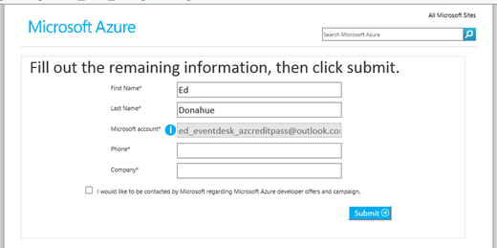
2. Sign into a Microsoft account to continue. If you have an account password saved or you automatically sign into other Microsoft services that Microsoft account will be used to redeem the promo code. (Note: if you have a corp MSFT account, @microsoft.com, please use InPrivate browsing. Otherwise the corp account will be your Microsoft account and the code will be wasted.)
3. Fill out the remaining information and click “Submit.”

Slide 31
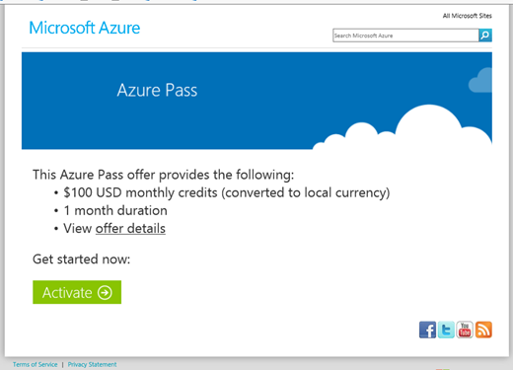
4. Review the Azure Pass offer and click “Activate.”

Slide 32
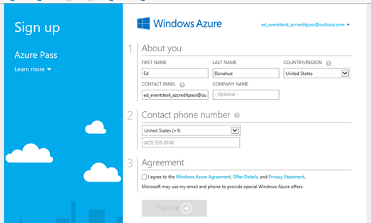
5. Fill out the rest of the required information and click “Sign up.”

Slide 33
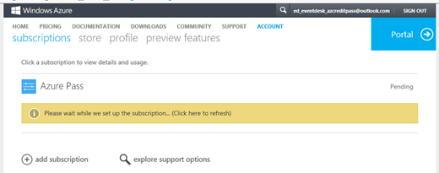
6. The subscription will take 3-10 minutes to activate.

Slide 34
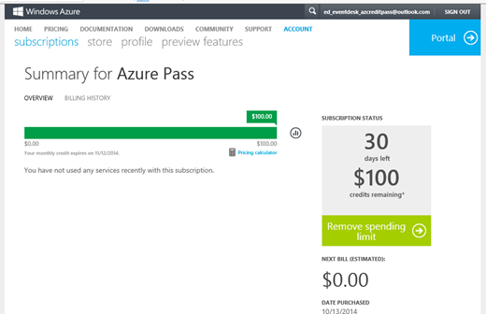
7. Once activated, you will be redirected to the summary page

